Slide 1
Self playing guitar
Presenters: Kiril Voigtlaender & Kareem de Quillettes

Slide 2
Needed parts
Guitar -> self provided
Microcontroller
Servos
Voice Sensor
Self made parts
Preferred language python

Slide 3
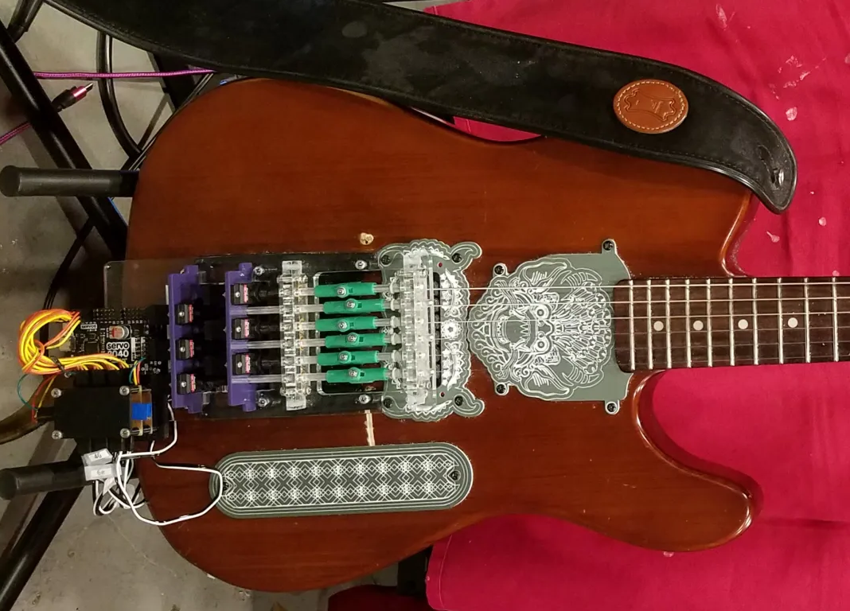

Slide 4
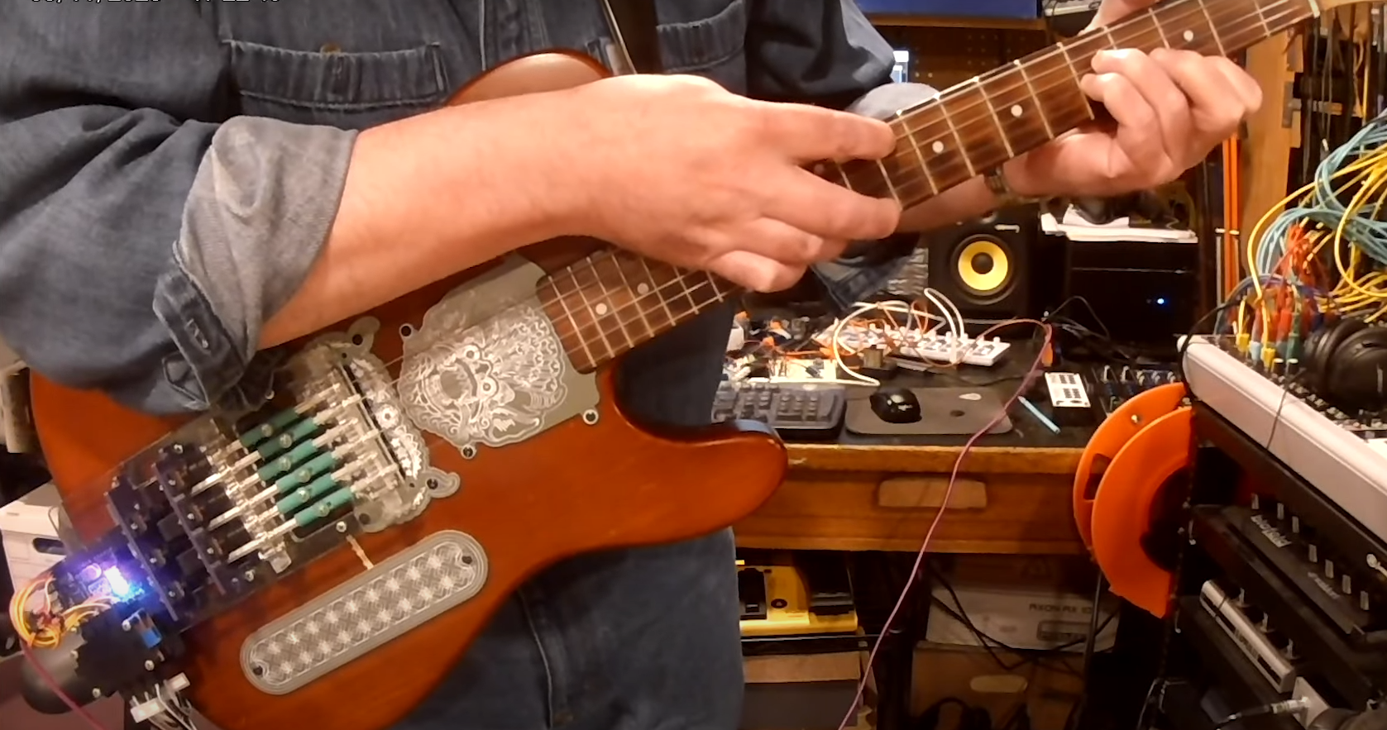

Slide 5
What exactly are we doing?
Existing idea -> our base
Self fretting
Voice control
Website

Slide 6
Time management
2 and a half weeks for building the mechanism for one string
1 work group to multiply the amount of working strings
3 weeks for fretting the strings
1 week for turning midi into music
1 week for voice control + Webpage
2 weeks remain free for now, room for errors

Slide 7
Questions? If yes keep them for yourself ☺ Criticism? Go fuck yourself ☺

Slide 8
Link to the already build project
https://makezine.com/article/craft/music/how-i-built-a-guitar-picking-robot/

